Slide 1
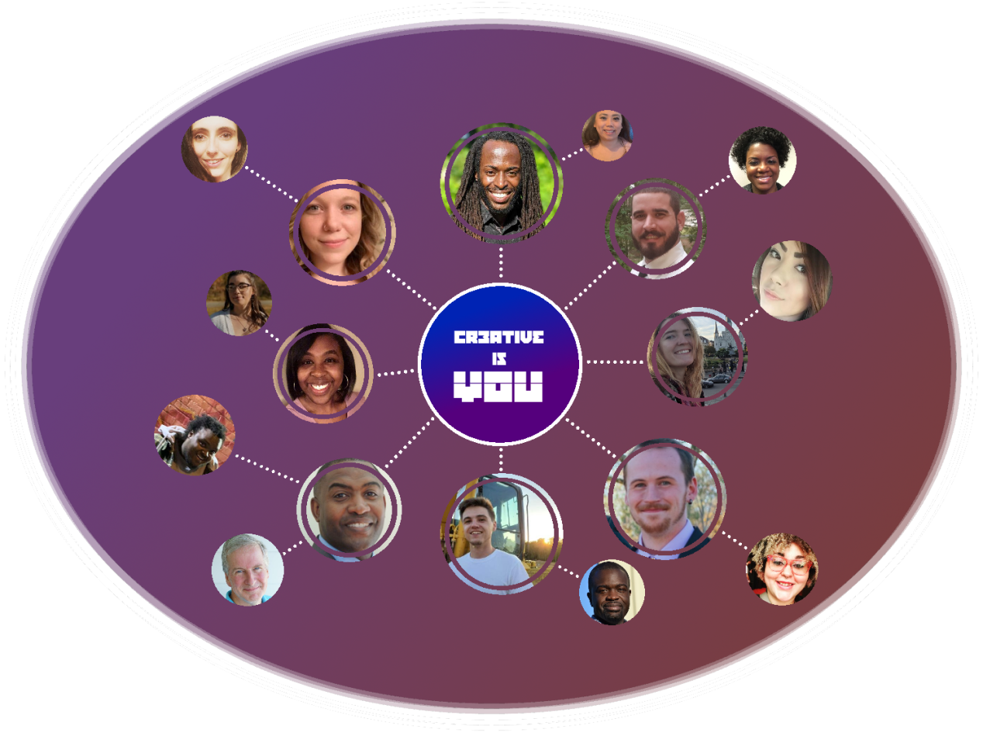
CR3ATIVE
CONNECT. COLLAB. CREATE.

Slide 2
What is Cr3Ative?
Cr3ative is a mobile first web application to promote art collaboration in all forms.
Cr3ative allows you to create exceptional works and exchange value with other artists.
We believe in the power of working together.
We facilitate opportunities for artists to work and play together in meaningful ways.

Slide 3
Motivation behind cr3ative
To give creatives opportunities and a space to connect and collaborate with like-minded individuals and create works of art that they are passionate about.
Open for professionals looking to build their portfolios or for those looking to create for fun.

Slide 4
User story
AS a PROFESSIONAL CREATIVE
I WANT to CONNECT with other like-minded creatives
SO THAT I can COLLABORATE and CREATE works of art that are important to me

Slide 5
Application Requirements
ReactJS
Node/Express Web server
Backed by MySQL or MongoDB with a Sequelize or Mongoose ORM
Must have both GET and POST routes for retrieving and adding new data
Deployed to Heroku
Utilize (at least) 2 new libraries, packages, or technologies (Cloudinary, Concurrently)
Authentication of users
Polished front end/UI
Folder structure meets MVC paradigm
Protect API keys in Node with environmental variables

Slide 6
Tasks and Roles
Tristan: Front-end/Components, Back-end Integration, Floating
Dallis: Database, User Auth Integration, Design, Routes
Jesse: Server, Database, User Auth Set-up
Allison: Front-end/Components, Views, Design

Slide 7
Challenges and Successes
Challenges:
Different schedules/holiday plans
Working with new technologies
Successes:
Creative (no pun intended?) idea
Photo Editor feature
Finishing our last project for the class

Slide 8
DEMO

Slide 9
Directions for future development
“Request Collab” feature that will send an app message and/or email to the user.
Different profile editor templates users can choose from.
Collab Showcase page, where creatives can show off their work achieved by connecting, collaborating and creating with others through the app.

Slide 10
Links
Deployed:
GitHub Repo:

Slide 11




Thank you from The Cr3ATive Team!

